Slide 1
BITS Pilani
Prof.Aruna Malapati
Department of CSIS

Slide 2
Word Representations

Slide 3
Today’s Agenda
Representing words as vectors
One hot vector
TF-IDF Vectors
Co-occurance vectors

Slide 4
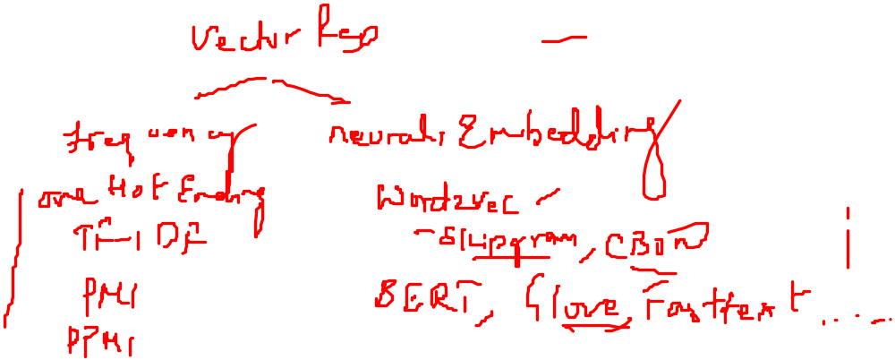

Why convert word to vectors?
Most of the Machine Learning algorithms use numbers as inputs.
In the NLP world we are dealing with characters / Text hence we methods to convert the Text into numbers.
Notes:
https://aegis4048.github.io/demystifying_neural_network_in_skip_gram_language_modeling#eq-14
https://www.cl.uni-heidelberg.de/courses/ss19/emb/material/word2vec2.pdf
https://cs224d.stanford.edu/lecture_notes/notes1.pdf
https://deepdatascience.wordpress.com/2017/04/25/word2vec-continous-bag-of-words/
http://mccormickml.com/assets/word2vec/Alex_Minnaar_Word2Vec_Tutorial_Part_II_The_Continuous_Bag-of-Words_Model.pdf
https://www.youtube.com/watch?v=G5ah0QqkUgE&list=PLxlkzujLkmQ8erDs5VSteKTmVg-y9Z1dR&index=8

Slide 5
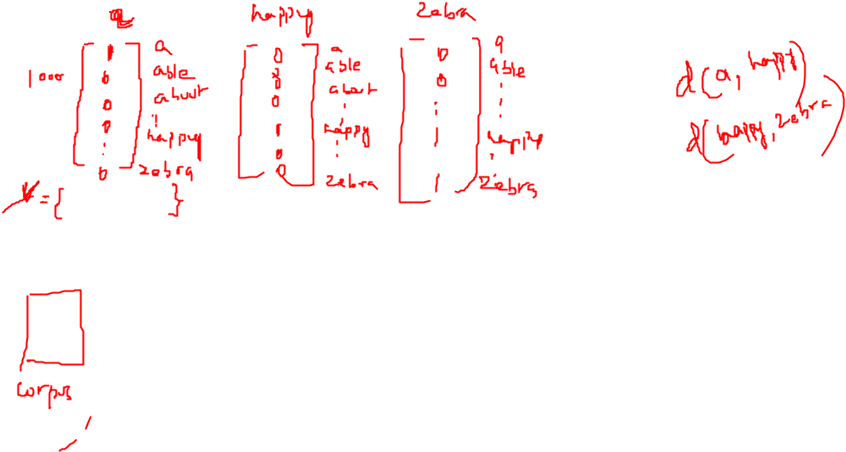
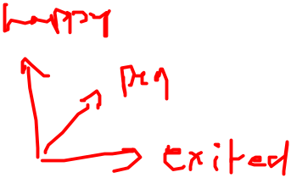
One hot encoding

Slide 6
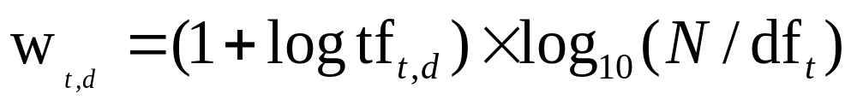
TF-IDF Vectors
The tf-idf weight of a term is the product of its tf weight and its idf weight.
Best known weighting scheme in information retrieval
Increases with the number of occurrences within a document
Increases with the rarity of the term in the collection
Notes:
Not a great measure of association between words

Slide 7
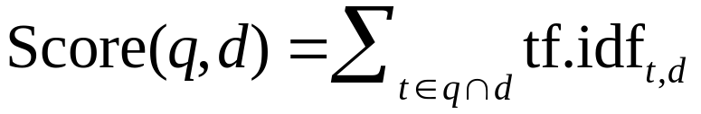
tf-idf weighting for document and queries
Example :D1: The restaurants are in the city.
D2:The resorts are in the outskirts.
V={are, city, in outskirts, resorts, restaurants, the}
Q= {resorts,outskirts}
 | TF-D1 | IDF-D1 | TF-IDF(D1) | TF-D2 | IDF-D2 | TF-IDF(D2) | TF-Query | IDF-Query | TF-IDF Query
are | 1+log 1=1 | log2/2=0 | 0 | 1+log 1=1 | log2/2=0 | 0 | 0 | log2/2=0 | 0
city | 1+log 1=1 | log2/1=0.3 | 0.3 | 0 | log2/1=0.3 | 0 | 0 | log2/1=0.3 | 0
in | 1+log 1=1 | log2/2=0 | 0 | 1+log 1=1 | log2/2=0 | 0 | 0 | log2/2=0 | 0
outskirts | 0 | log2/1=0.3 | 0 | 1+log 1=1 | log2/1=0.3 | 0.3 | 1+log 1=1 | log2/1=0.3 | 0.3
resorts | 0 | log2/1=0.3 | 0 | 1+log 1=1 | log2/1=0.3 | 0.3 | 1+log 1=1 | log2/1=0.3 | 0.3
restaurants | 1+log 1=1 | log2/1=0.3 | 0.3 | 0 | log2/1=0.3 | 0 | 0 | log2/1=0.3 | 0
the | 1+log 2=1.3 | log2/2=0 | 0 | 1+log 2=1.3 | log2/2=0 | 0 | 0 | log2/2=0 | 0

Slide 8


Pointwise Mutual Information (PMI)
Pointwise mutual information: Do events x and y co-occur more than if they were independent?
PMI between two words: (Church & Hanks 1989) Do words x and y co-occur more than if they were independent?

Slide 9
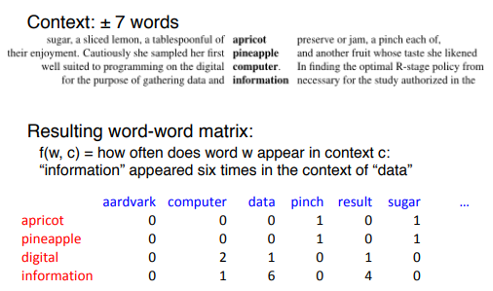
Word-Word Matrix

Slide 10
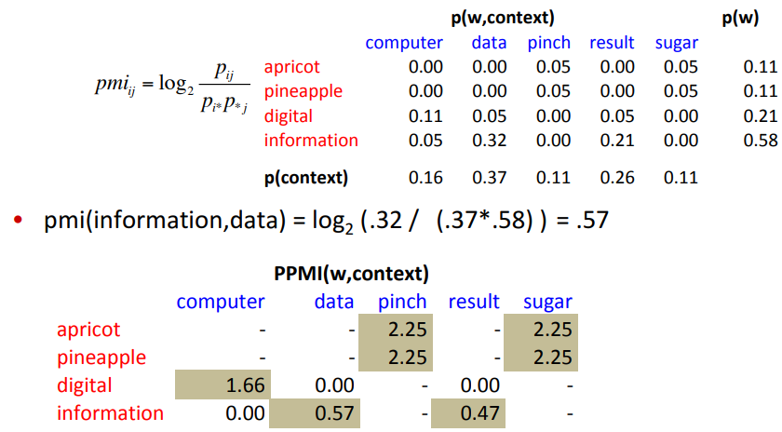
PMI Vectors

Slide 11
What are simple tests for understanding meaning?
Which of the following means same as pulchritude:
(a) Truth (b) Disgust (c) Anger (d) Beauty?
Analogy questions:
Man : Woman :: King : ??
“How can we teach a computer the notion of word similarity?”

Slide 12
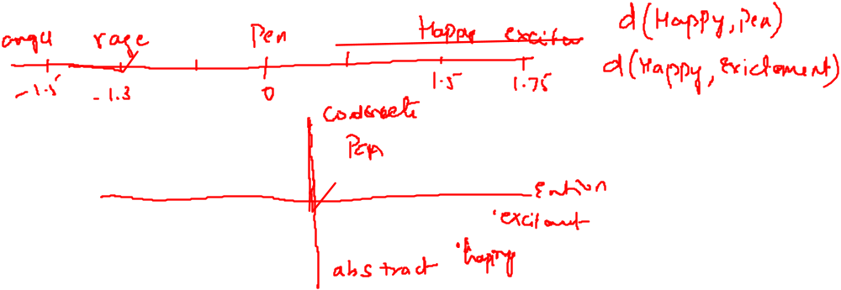
Neural Word Embeddings
A word embedding is a numerical representation of a word.
These vectors carry the meaning of the word or embed meaning and are of low dimensions.

Slide 13
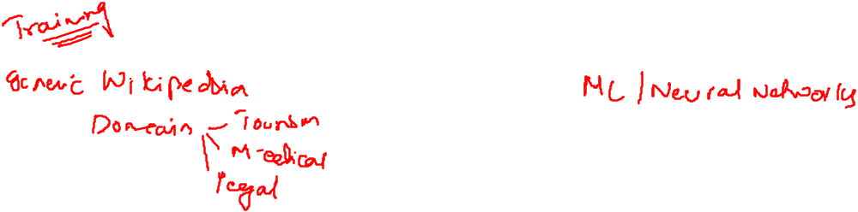
Two ingredients for generating word embeddings
Corpus
Embedding Method

Slide 14
Word embedding methods
Word2Vec
Global Vectors (Glove)
FastText
BERT
ELMO
GPT-2

